Slide 1

Session 06
Introduction to Information Systems

Slide 2
Learning Objective
Knowing the potential impact of information systems and having the ability to put this knowledge to work can result in a successful personal career and in organizations that reach their goals
Describe the components of computer-based information systems.
Describe the various types of information systems by breadth of support.
Identify the major information systems that support each organizational level.
Describe strategic information systems (SISs) and explain their advantages.
Describe the fundamental of database technology
Describe how information resources are managed and discuss the roles of the information systems department and the end users.
Knowing the training program of Information Systems Major
NMCNTT- FIT - HCMUS

Slide 3
Content
Why learn about Information Systems
What is an Information System
Computer Based Information Systems
Business Information Systems
Database Fundamentals
Careers in Information Systems
Information Systems Major
NMCNTT- FIT - HCMUS

Slide 4
Why Learn About Information System?
NMCNTT- FIT - HCMUS

Slide 5
Why Learn About IS?
There are many examples of the ways in which information systems and technologies are embedded in your lives:
Register for classes
Take classes, and not just classes from your university
Access class syllabi, information, PowerPoints, and lectures
Research class papers and presentations
Conduct banking
Pay your bills
Research, shop, and buy products from companies or other people
Sell your “stuff ”
Search for, and apply for, jobs
Make your travel reservations (hotel, airline, rental car)
NMCNTT- FIT - HCMUS

Slide 6
Why Learn About IS?
Information systems are used in almost every profession, including:
Entrepreneurs
Small companies to large multinationals
Accounting, marketing, management
Information systems are indispensable tools to help you to achieve your career goals
NMCNTT- FIT - HCMUS

Slide 7
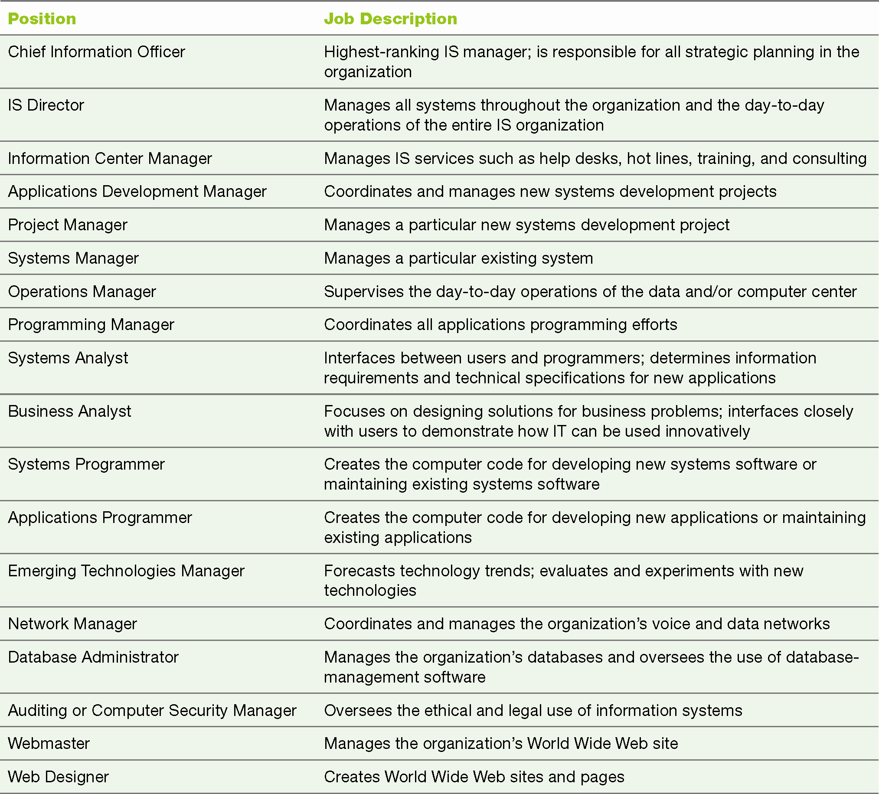
Why Learn About IS?
NMCNTT- FIT - HCMUS

Slide 8
What is an Information System?
NMCNTT- FIT - HCMUS

Slide 9
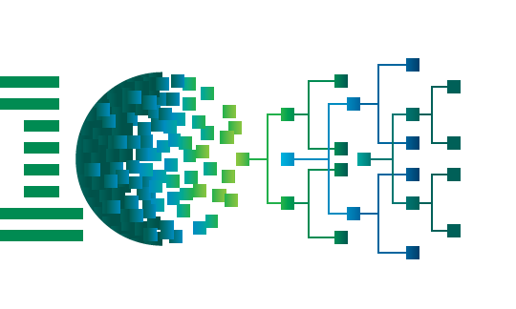
What is an information system?
A set of interrelated components that
collect/retrieve, process, store and distribute information
to support decision making and control in an organization
From ibmims

Slide 10
What is an information system?
Information system feedback can help organizations:
Achieve their goals
Increase revenues and reduce costs
Information concept:
One of an organization’s most valuable resources
Often confused with the term data
NMCNTT- FIT - HCMUS

Slide 11
What is an Information System?
An information system (IS) is a set of interrelated elements that:
Collect (input)
Manipulate (process)
Store
Disseminate (output) data and information
Provide a corrective reaction (feedback mechanism) to meet an objective
NMCNTT- FIT - HCMUS

Slide 12
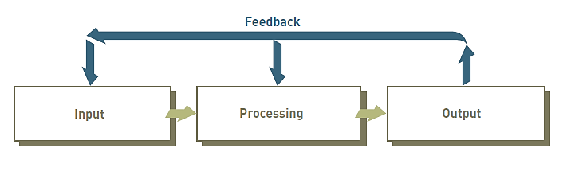
Components of an IS
NMCNTT- FIT - HCMUS

Slide 13
Input, Processing, Output, Feedback
Input: activity of gathering and capturing raw data
Processing: converting data into useful outputs
Output: production of useful information
Usually in the form of documents and reports
Feedback: information from the system
Used to make changes to input or processing activities
NMCNTT- FIT - HCMUS

Slide 14
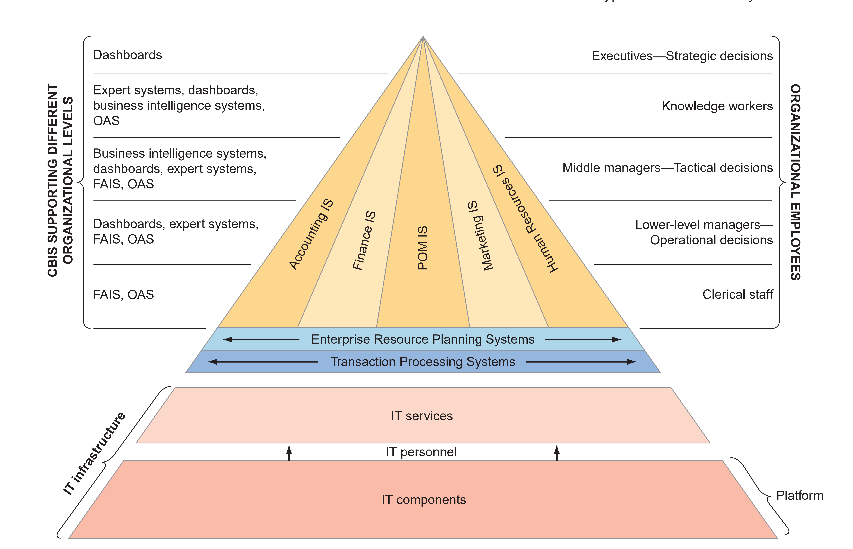
Type of Information Systems
NMCNTT- FIT - HCMUS
Notes:
Each information system supports a particular functional area in the organization. Examples are accounting IS, finance IS, production/operations management (POM) IS, marketing IS, and human resources IS

Slide 15
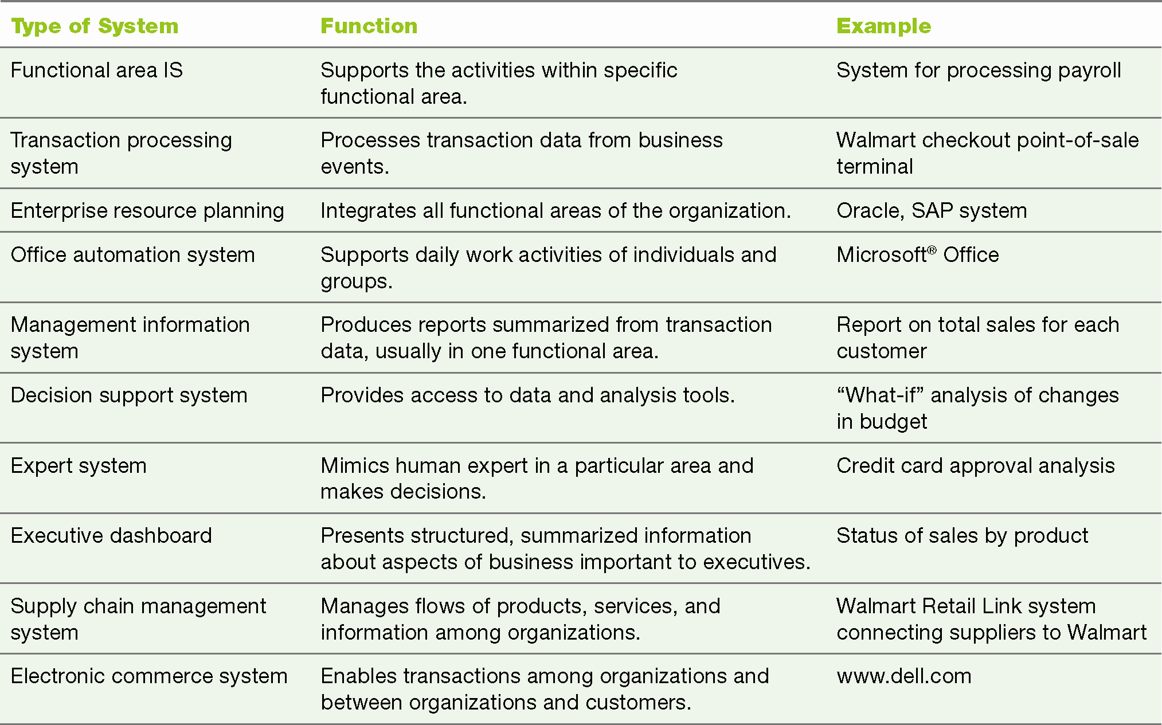
Type of Information Systems
NMCNTT- FIT - HCMUS

Slide 16
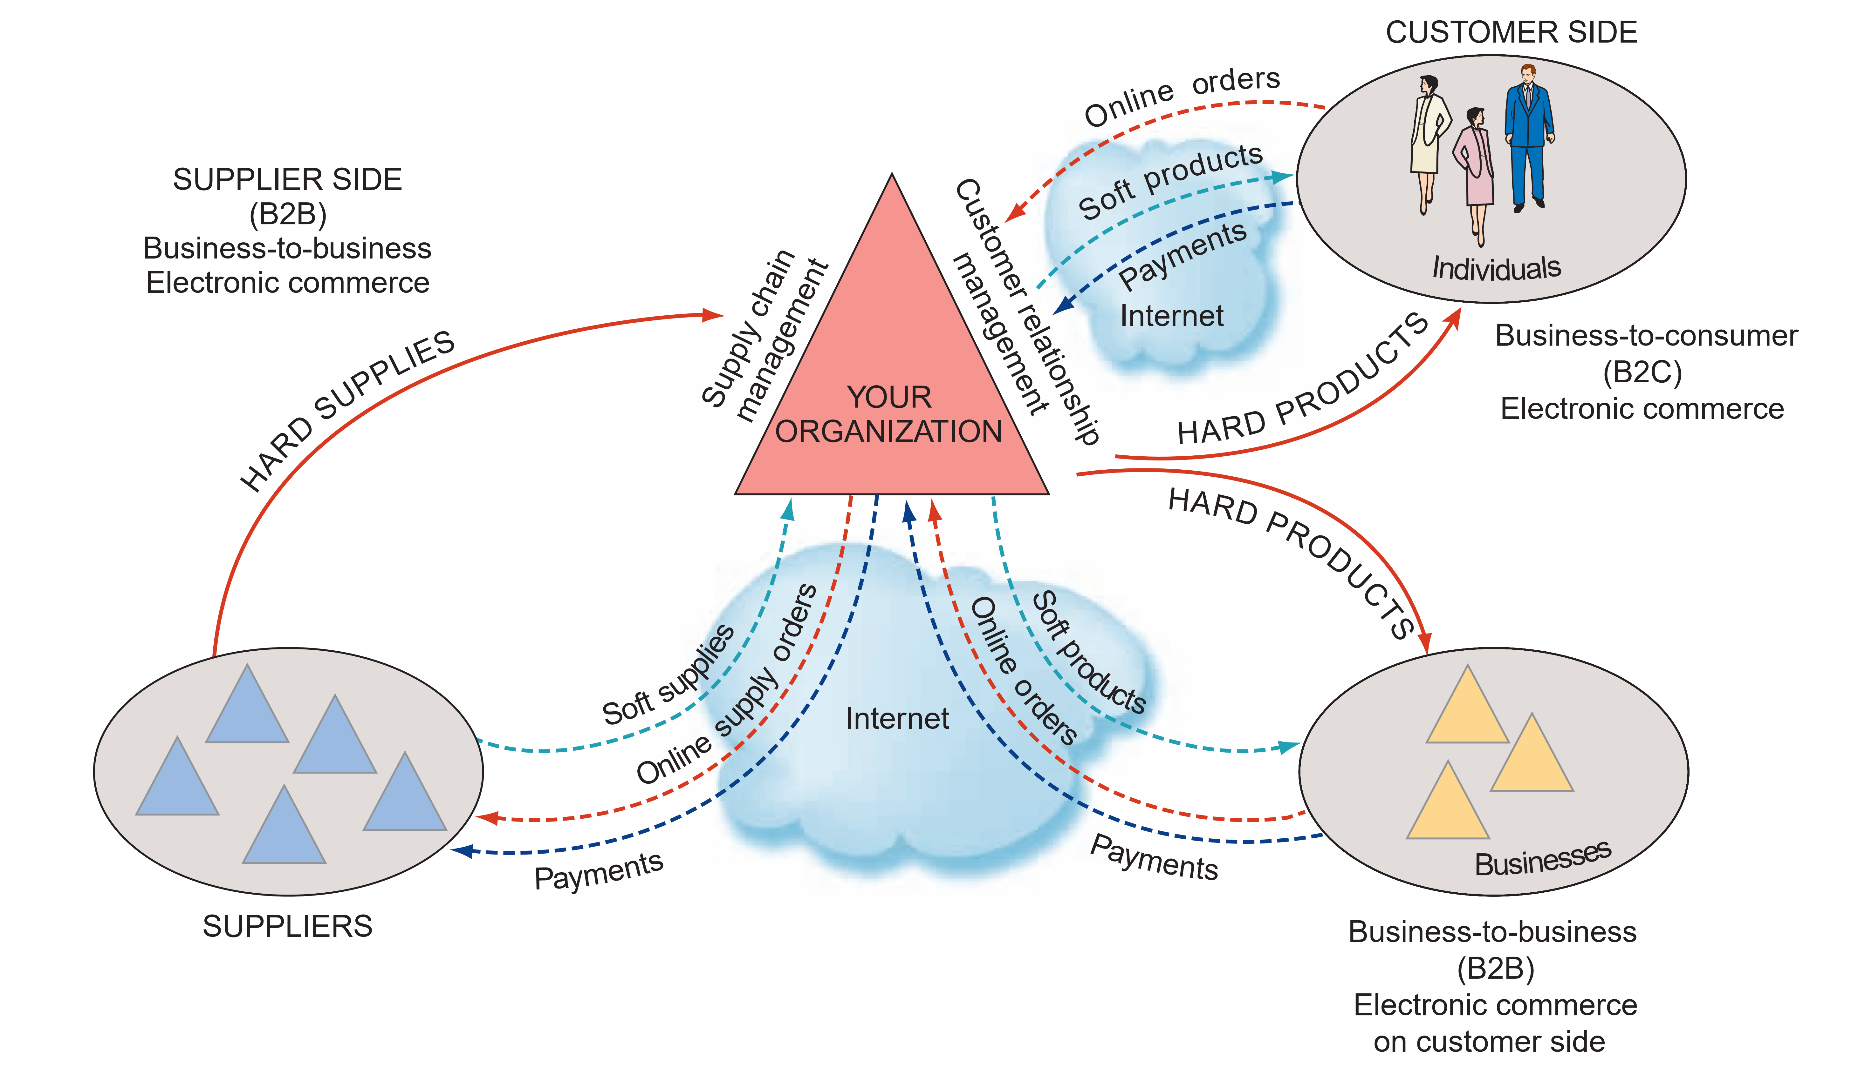
Type of Information Systems
NMCNTT- FIT - HCMUS

Slide 17
Concepts of Information System
Information vs. Data
Business process (quy trình nghiệp vụ)
Information system development process
Information system development tools

Slide 18
Data, Information, and Knowledge
Data: raw facts
Information: collection of facts organized in such a way that they have value beyond the facts themselves
Process: set of logically related tasks performed to achieve a defined outcome
Knowledge: awareness and understanding of someone or something which is acquired through experience or education by perceiving, discovering, or learning
NMCNTT- FIT - HCMUS

Slide 19
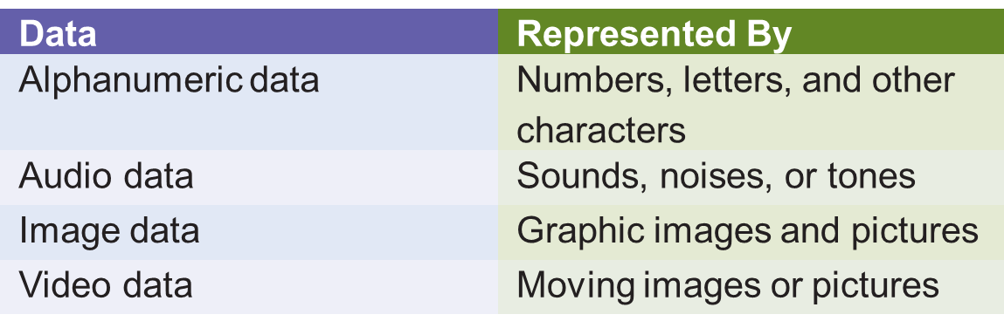
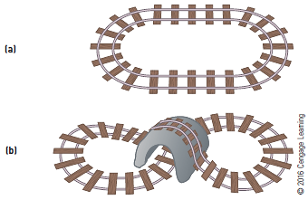
Data and Information
Types of Data
Data
Information
NMCNTT- FIT - HCMUS

Slide 20
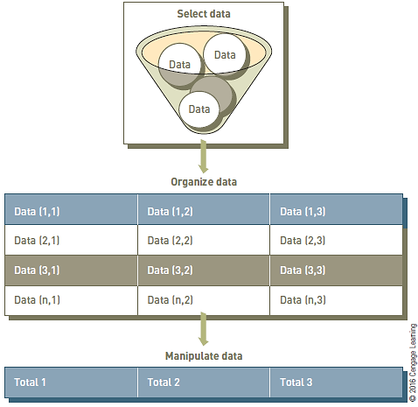
Process of Transforming Data into Information
NMCNTT- FIT - HCMUS

Slide 21
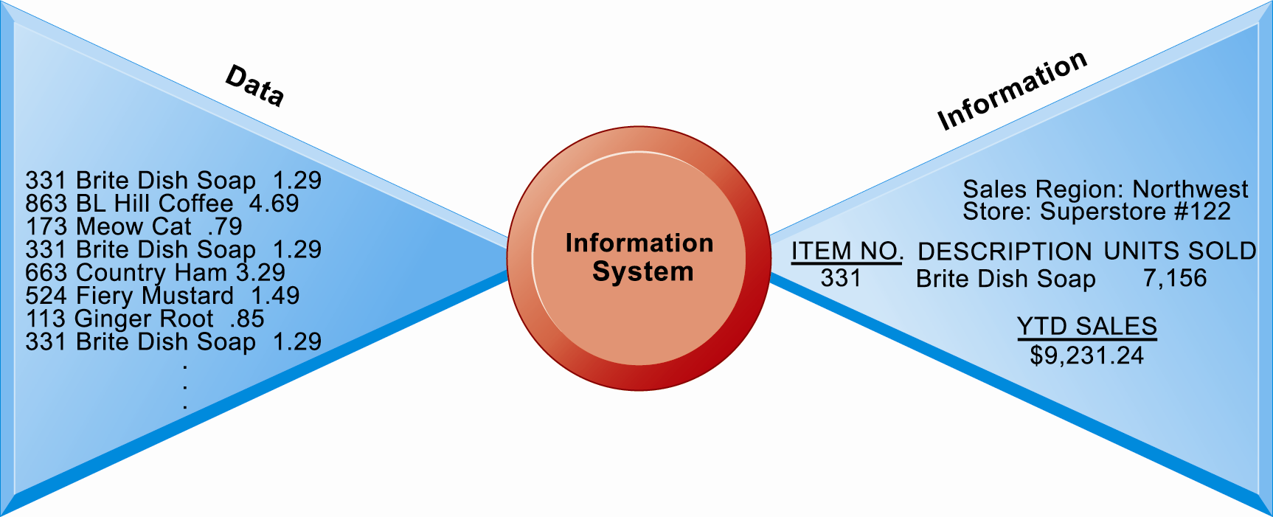
Information vs. data
Data are streams of raw facts
Information is data shaped into meaningful form
From Laudon, 2016

Slide 22
Characteristics of Valuable Information
The value of information is directly linked to how it helps decision makers achieve their organization’s goals
Accuracy and completeness are critical for data used in accounting for the management of company assets, e.g., cash, inventory, and equipment
NMCNTT- FIT - HCMUS

Slide 23
Characteristics of Valuable Information
Characteristics | Definitions
Accessible | Information should be easily accessible by authorized users so they can obtain it in the right format and at the right time to meet their needs.
Accurate | Accurate information is error free. In some cases, inaccurate information is generated because inaccurate data is fed into the transformation process. This is commonly called garbage in, garbage out (GIGO).
Complete | Complete information contains all the important facts. For example, an investment report that does not include all important costs is not complete.
Economical | Information should also be relatively economical to produce. Decision makers must always balance the value of information with the cost of producing it.
Flexible | Flexible information can be used for a variety of purposes. For example, information on how much inventory is on hand for a particular part can be used by a sales representative in closing a sale, by a production manager to determine whether more inventory is needed, and by a financial executive to determine the total value the company has invested in inventory.
Relevant | Relevant information is important to the decision maker. Information showing that lumber prices might drop might not be relevant to a computer chip manufacturer.
NMCNTT- FIT - HCMUS

Slide 24
Characteristics of Valuable Information (cont’d.)
Characteristics | Definitions
Reliable | Reliable information can be trusted by users. In many cases, the reliability of the information depends on the reliability of the data-collection method. In other instances, reliability depends on the source of the information. A rumor from an unknown source that oil prices might go up might not be reliable.
Secure | Information should be secure from access by unauthorized users.
Simple | Information should be simple, not complex. Sophisticated and detailed information might not be needed. In fact, too much information can cause information overload, whereby a decision maker has too much information and is unable to determine what is really important.
Timely | Timely information is delivered when it is needed. Knowing last week’s weather conditions will not help when trying to decide what coat to wear today.
Verifiable | Information should be verifiable. This means that you can check it to make sure it is correct, perhaps by checking many sources for the same information.
NMCNTT- FIT - HCMUS

Slide 25
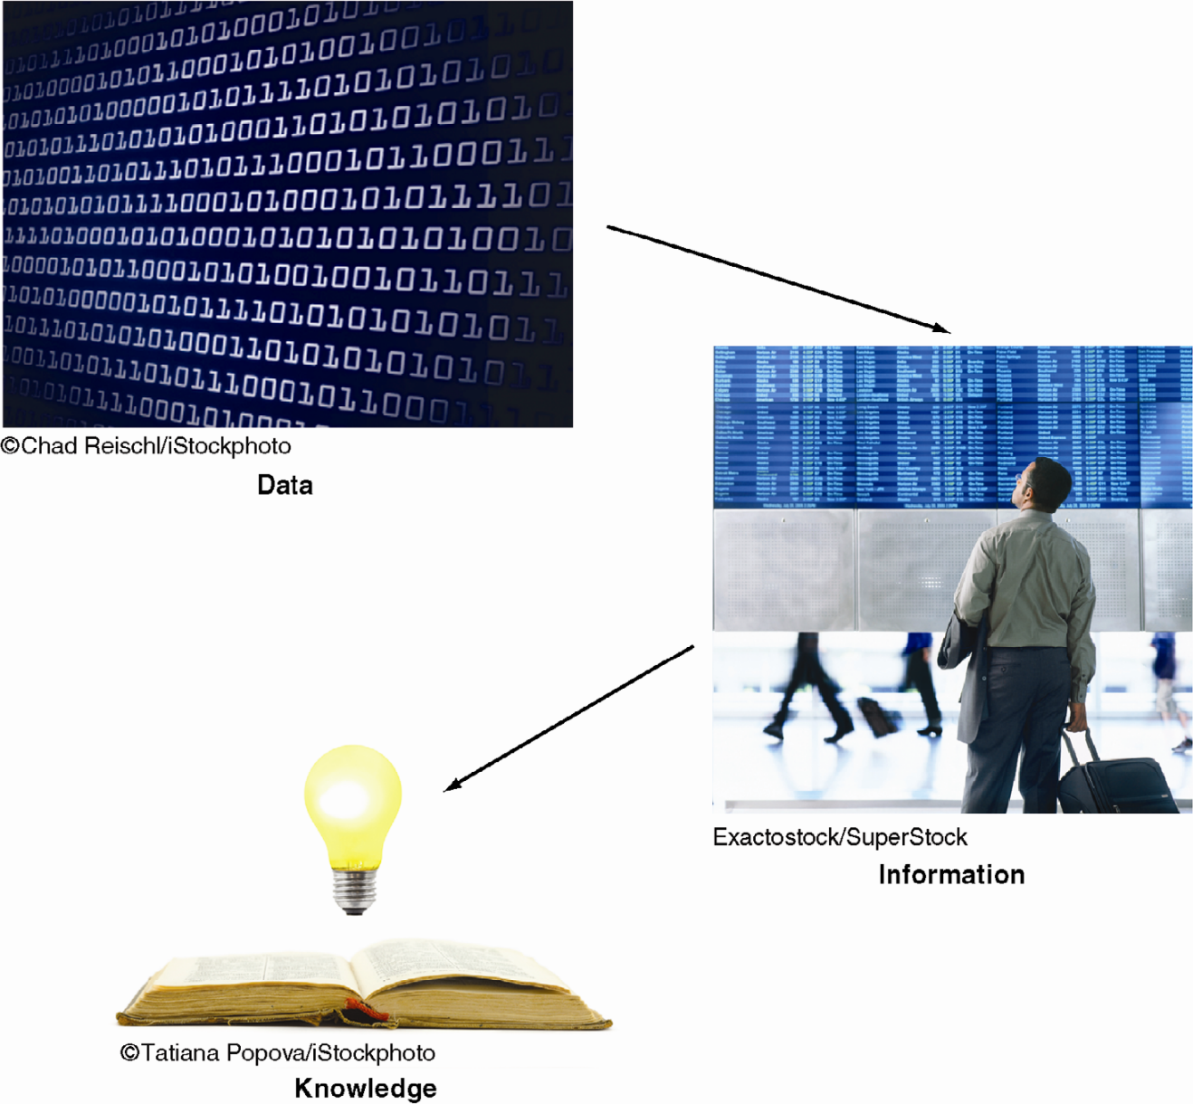
Data, Information, Knowledge
NMCNTT- FIT - HCMUS

Slide 26
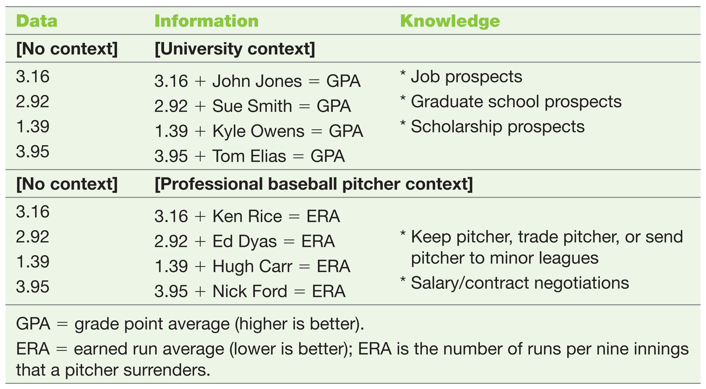
Data, Information, Knowledge
NMCNTT- FIT - HCMUS

Slide 27
What is a business process?
The manner in which work is organized, coordinated, and focused to produce a valuable product/service
The collection of activities required to produce a product/service
Supported by flows of material, information, and knowledge among the participants

Slide 28
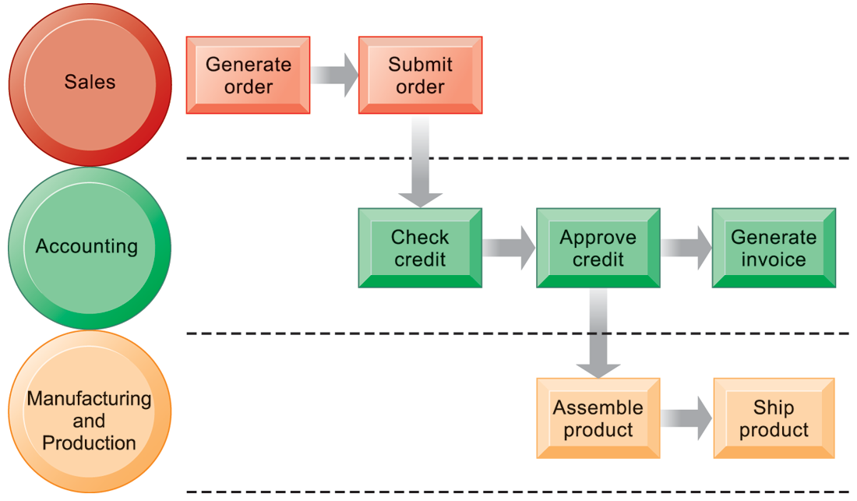
Example of a business process
The order fulfillment process

Slide 29
Information system development process
Similar to software development process
Information systems are expressed through application software
Specially focus to the end-user factor
End-user: a person who performs tasks of a business process

Slide 30
Information system development tools
Tools support following stages
Requirement collection and analysis
Business process analysis
Data analysis
Information system analysis and design
Testing
Deployment
Operations/Maintenance

Slide 31
Computer-Based Information System (CBIS)
NMCNTT- FIT - HCMUS

Slide 32
Computer-Based Information Systems (CBIS)
Definition: is an information system that uses computer technology to perform some or all of its intended tasks.
Companies are incorporating CBIS into their products and services
Example: investment tools for clients of Fidelity Investments
NMCNTT- FIT - HCMUS

Slide 33
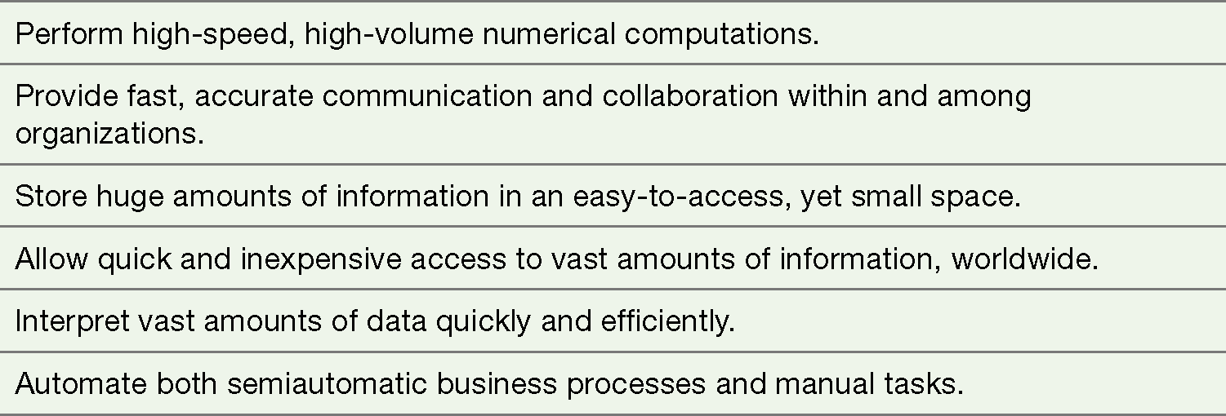
Computer-Based Information Systems (CBIS)
NMCNTT- FIT - HCMUS

Slide 34
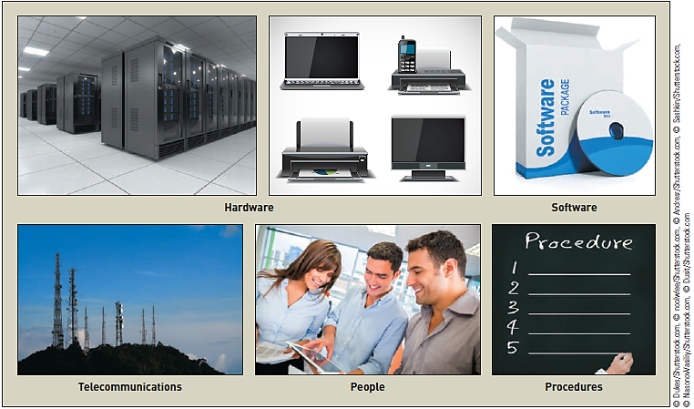
Components of a CBIS
NMCNTT- FIT - HCMUS

Slide 35
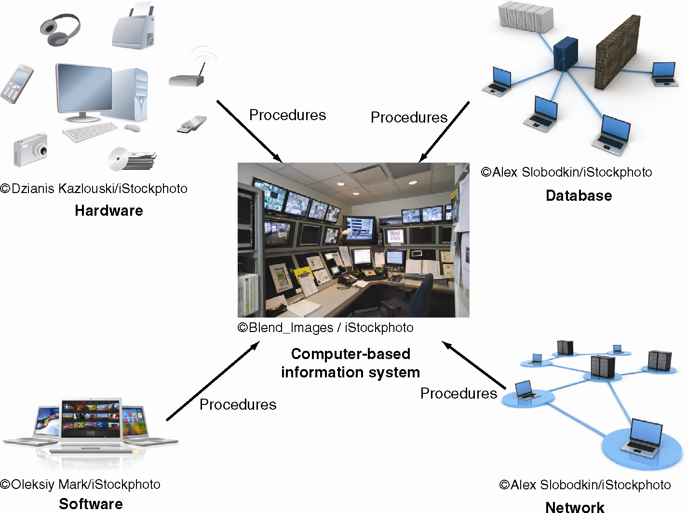
Components of a CBIS
NMCNTT- FIT - HCMUS

Slide 36
CBIS: Hardware, Software, and Databases
Hardware: computer equipment used to perform input, processing, storage, and output activities
Software: computer programs that govern the operation of the computer
Database: organized collection of facts and information
Typically consists of two or more related data files
NMCNTT- FIT - HCMUS

Slide 37
CBIS: Telecommunications, Networks, and the Internet
Telecommunications: electronic transmission of signals for communications
Networks connect computers and equipment enabling electronic communication
Internet: world’s largest computer network
Thousands of interconnected networks
NMCNTT- FIT - HCMUS

Slide 38
CBIS: Cloud-Computing and the Web
Cloud-computing environment:
Provides software and data storage via the Internet in order to:
Run services on another organization’s computer hardware
Easily access software and data
World Wide Web (WWW or Web)
Network of links on the Internet to documents containing text, graphics, video, and sound
NMCNTT- FIT - HCMUS

Slide 39
CBIS: Intranets and Extranets
Intranet: internal network that allows people within an organization to exchange information and work on projects
Extranet: network based on Web technologies
Allows selected outsiders, e.g., business partners and customers, to access authorized resources of a company’s intranet
NMCNTT- FIT - HCMUS

Slide 40
CBIS: People and Procedures
People are the most important element in most computer-based information systems
Procedures: strategies, policies, methods, and rules for using a CBIS
NMCNTT- FIT - HCMUS

Slide 41
Business Information System (BIS)
NMCNTT- FIT - HCMUS

Slide 42
Definition
Most common types of information systems:
Systems for electronic and mobile commerce, transaction processing, management information, and decision support
Special-purpose systems are utilized by some companies
Example: virtual reality
NMCNTT- FIT - HCMUS

Slide 43
Why BIS important?
Operational Excellence
Improve the efficiency of operations in order to achieve higher profitability. E.g. having the correct amount of stock in store so consumers can always get want they want
New product services and business models
IS systems play a major role for businesses in creating new products and services. New business models can be created and these can describe how a company produce, create and sell there products.
Customer and Supplier intimacy
The better services a company provides its consumers with more likely they are too come back to them and as result the more they will buy off the supplier therefore creating a good relationship with both parties.

Slide 44
Why BIS important?
Improved decision making
Managers can use real time data to make better decisions and not have to waste time looking for information.
Competitive advantage
IS systems will generally create a competitive advantage over their rivals
Day to Day survival
Business invest in these systems to make their jobs as easy as possibly.
Example: is Citibank introduced the first ATM machine to make it easier for customers to access their money and to cut down queues in their banks.

Slide 45
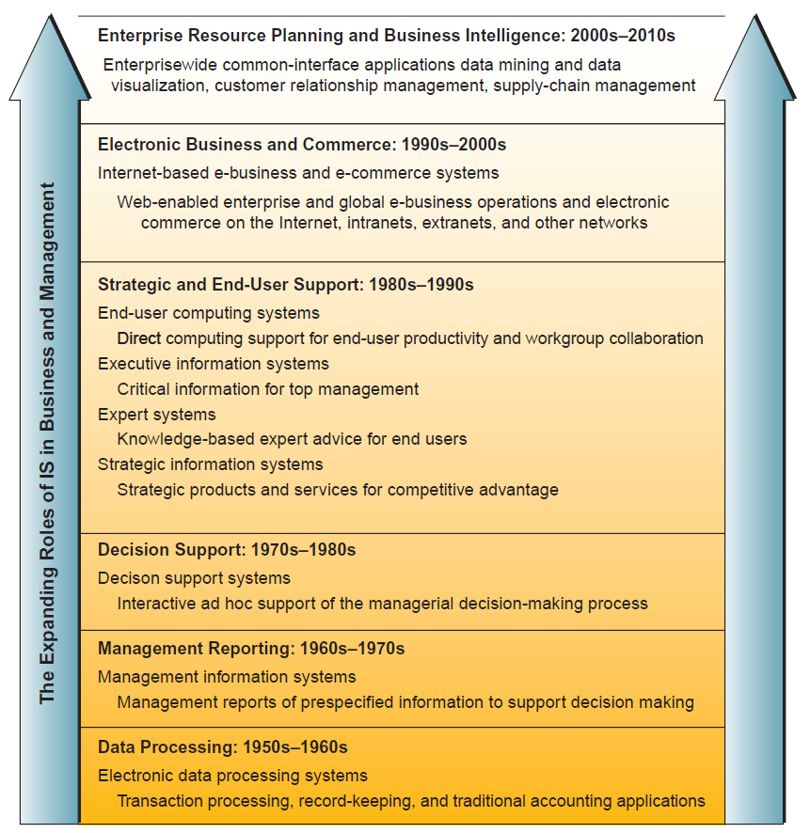
Trends

Slide 46
Major branches of BIS
BIS
E-Commerce, E-Business, Mobile Commerce
Transaction Processing Systems
Enterprise Systems – ERP
Decision Support System
Knowledge Management
Artificial Intelligence
Expert Systems
Management Information Systems
Business Intelligence and Data warehouse
Database Management

Slide 47
Major branches of BIS
Execute information systems
Decision Support Systems
Management Information Systems
Operations Support Systems (Transaction Processing Systems, Process Control Systems, Enterprise collaboration systems)
Enterprise Systems - ERP
Data Management (Database, Advanced DB, DBMS, etc.)
Security in Information Systems
Executives
Business Intelligent & Data warehouse
Knowledge Management
Expert Systems
Senior managers
Artificial Intelligence
E-Commerce, e-business, mobile commerce
Middle managers
Staff

Slide 48
Electronic and Mobile Commerce
E-commerce: business transactions executed electronically
Business-to-business (B2B)
Business-to-consumer (B2C)
Consumer-to-consumer (C2C)
Between business and the public sector
Between consumers and the public sector
NMCNTT- FIT - HCMUS

Slide 49
Mobile Commerce, E-commerce, and Electronic Business
Mobile commerce (m-commerce): the use of mobile, wireless devices to place orders and conduct business
E-commerce offers many advantages for streamlining work activities
Electronic business (e-business) uses information systems and the Internet to perform all business-related tasks and functions
NMCNTT- FIT - HCMUS

Slide 50
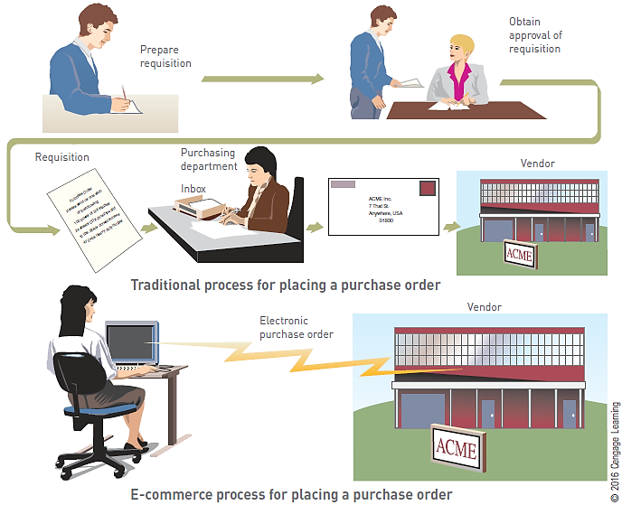
Electronic Commerce
NMCNTT- FIT - HCMUS

Slide 51
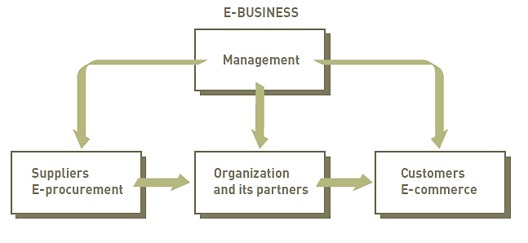
Electronic Business (E-business)
NMCNTT- FIT - HCMUS

Slide 52
Enterprise Systems- Transaction Processing Systems
Transaction
Any business-related exchange, such as payments to employees and sales to customers
Transaction processing system (TPS)
An organized collection of people, procedures, software, databases, and devices
Used to perform and record completed business transactions
NMCNTT- FIT - HCMUS

Slide 53
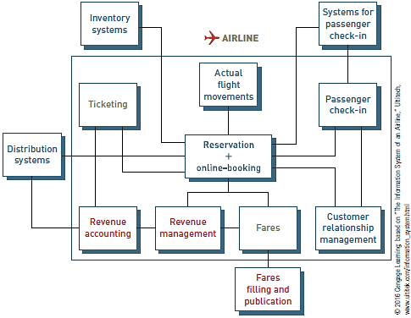
Integrated Transaction Processing System
NMCNTT- FIT - HCMUS

Slide 54
Enterprise Systems- Enterprise Resource Planning
Enterprise resource planning (ERP) system
A set of integrated programs
Manages the vital business operations for an entire multisite, global organization
Most ERP systems provide integrated software to support manufacturing and finance
NMCNTT- FIT - HCMUS

Slide 55
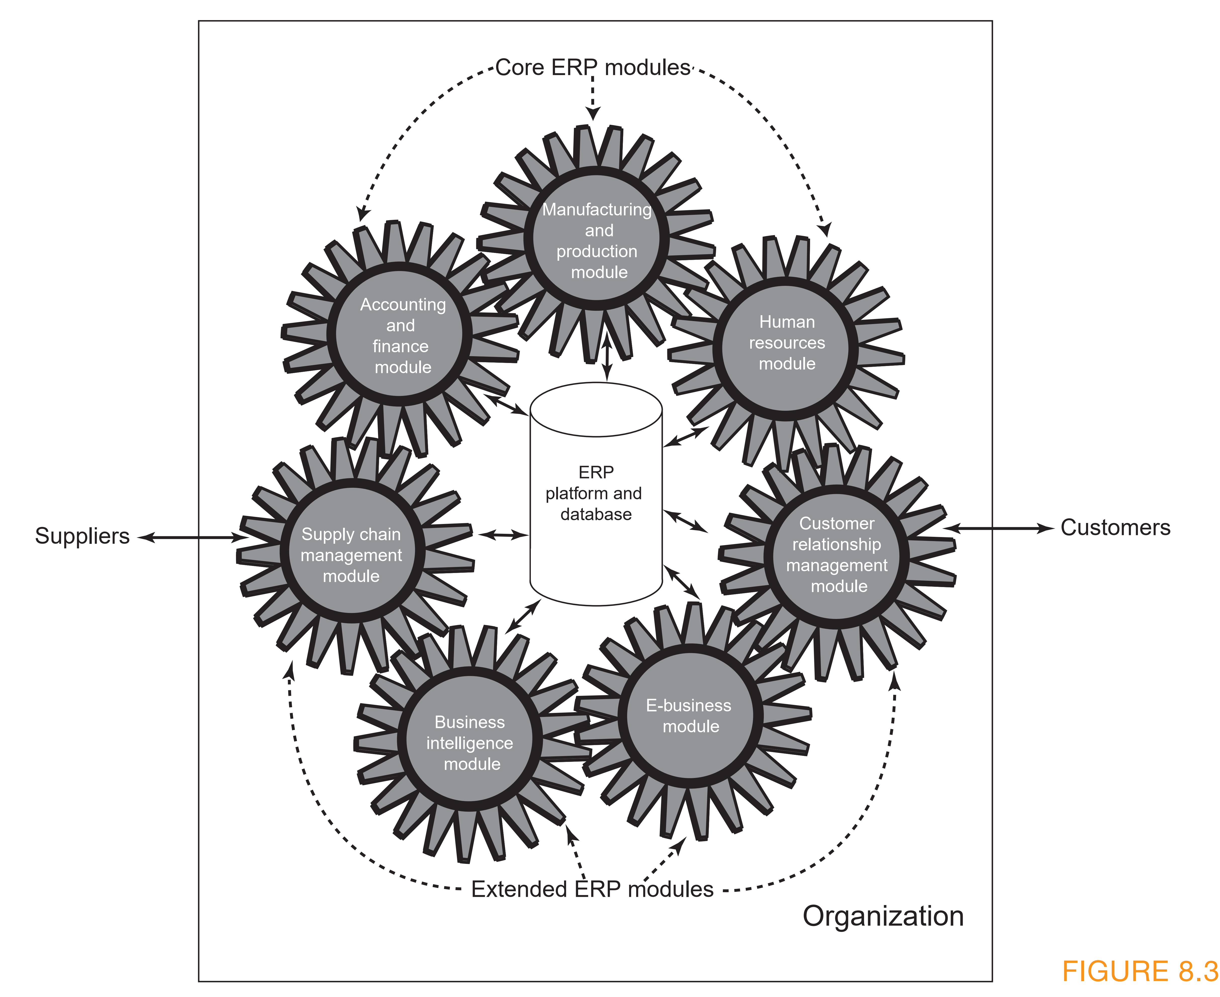
ERP II System
NMCNTT- FIT - HCMUS

Slide 56
Information and Decision Support Systems
Management information system (MIS)
Organized collection of people, procedures, software, databases, and devices
Provides routine information to managers and decision makers
Focuses on operational efficiency
Provides standard reports generated with data and information from the TPS or ERP

Slide 57
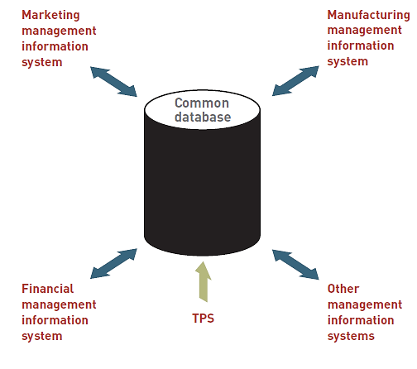
Management Information System
NMCNTT- FIT - HCMUS

Slide 58
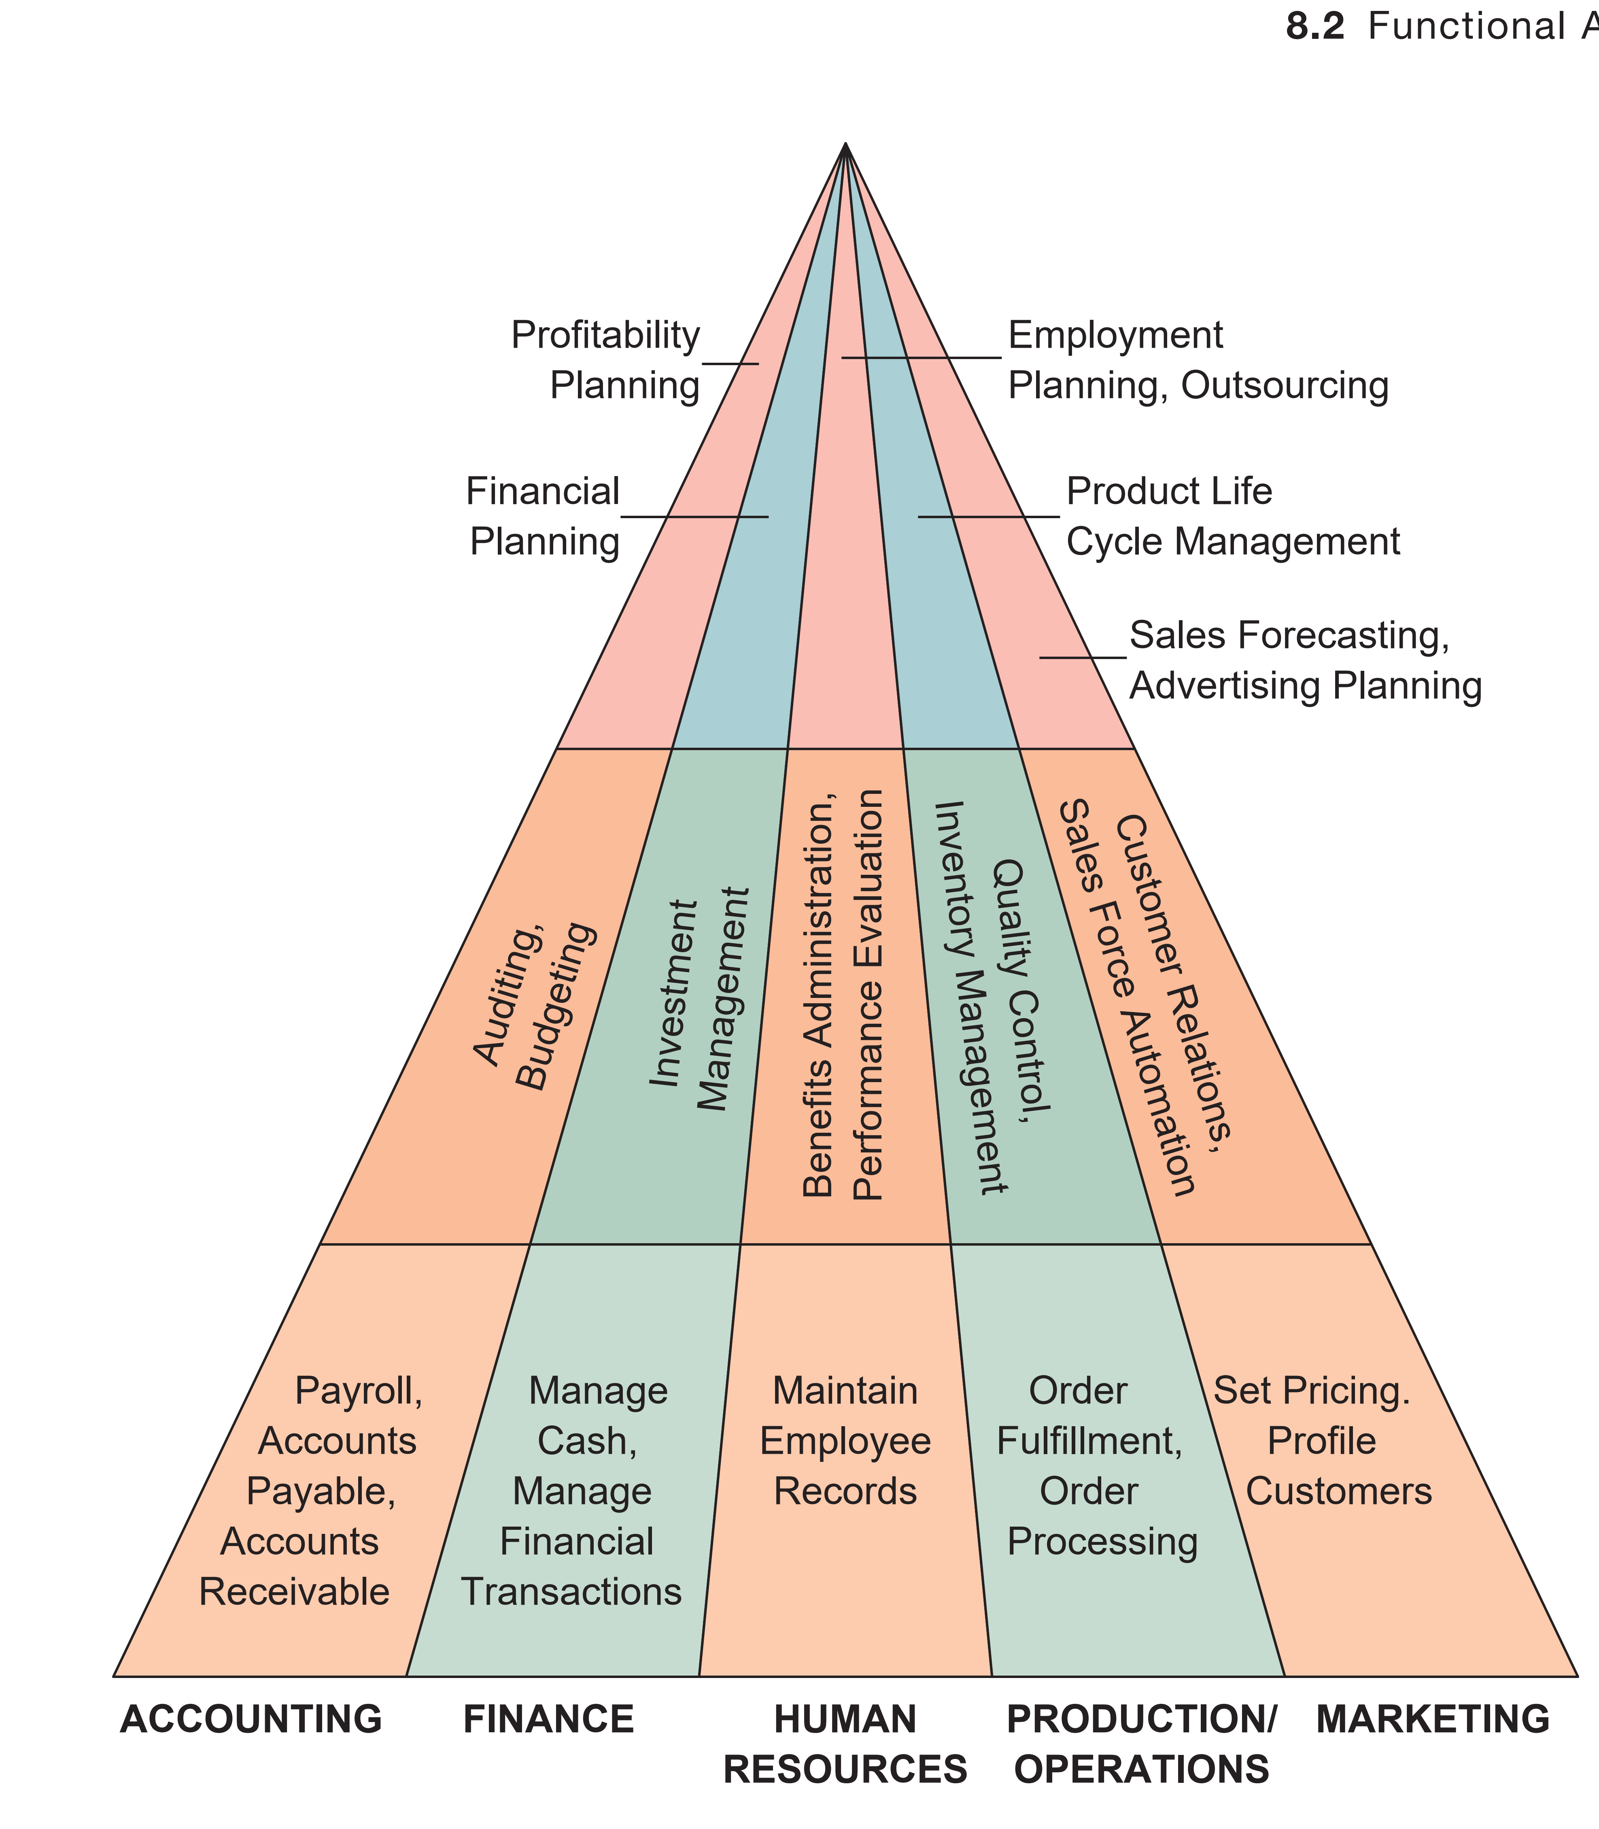
NMCNTT- FIT - HCMUS

Slide 59
Decision Support System (DSS)
An organized collection of people, procedures, software, databases, and devices that support problem-specific decision making
Focus is on making effective decisions
A DSS can include the following:
Model base
Database
User interface or dialogue manager
NMCNTT- FIT - HCMUS

Slide 60
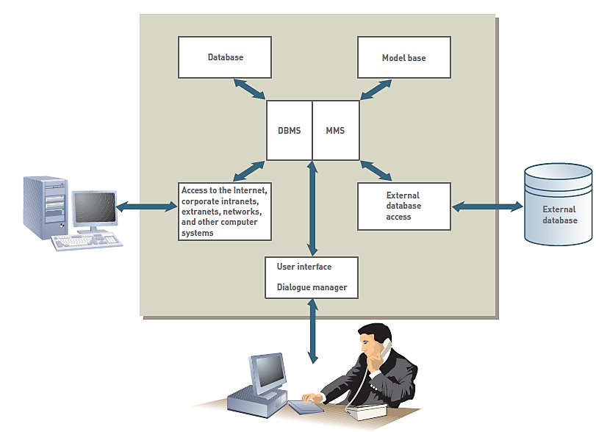
Essential DSS Elements
NMCNTT- FIT - HCMUS

Slide 61
Knowledge Management
Knowledge management systems (KMSs)
An organized collection of people, procedures, software, databases, and devices
Create, store, share, and use the organization’s knowledge and experience
NMCNTT- FIT - HCMUS

Slide 62
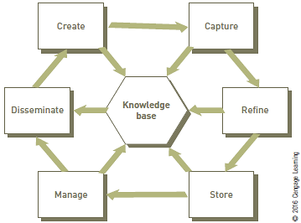
Knowledge Management Process
NMCNTT- FIT - HCMUS

Slide 63
Artificial Intelligence (AI)
A computer system takes on characteristics of human intelligence
Examples of AI applications: games, medical diagnoses, and automobile operation
NMCNTT- FIT - HCMUS

Slide 64
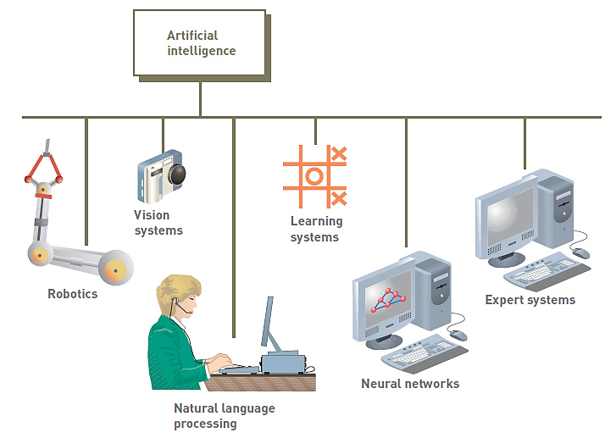
Major Branches of Artificial Intelligence
NMCNTT- FIT - HCMUS

Slide 65
Artificial Intelligence Subfields
Robotics: machines take over complex, dangerous, routine or boring tasks
Vision systems allow devices to see, store and process images
Natural language processing involves computers understanding and acting on verbal or written commands
Learning systems allow computers to learn from past mistakes or experiences
Neural networks allow computers to recognize and act on patterns or trends
NMCNTT- FIT - HCMUS

Slide 66
Expert Systems and Virtual Reality
Expert systems give computers the ability to make suggestions and function like an expert in a particular field
Knowledge base contains data, rules, procedures, and relationships used by expert system
Virtual reality: simulation of a real or imagined environment that can be experienced visually in three dimensions
NMCNTT- FIT - HCMUS

Slide 67
Database Fundamentals
NMCNTT- FIT - HCMUS

Slide 68
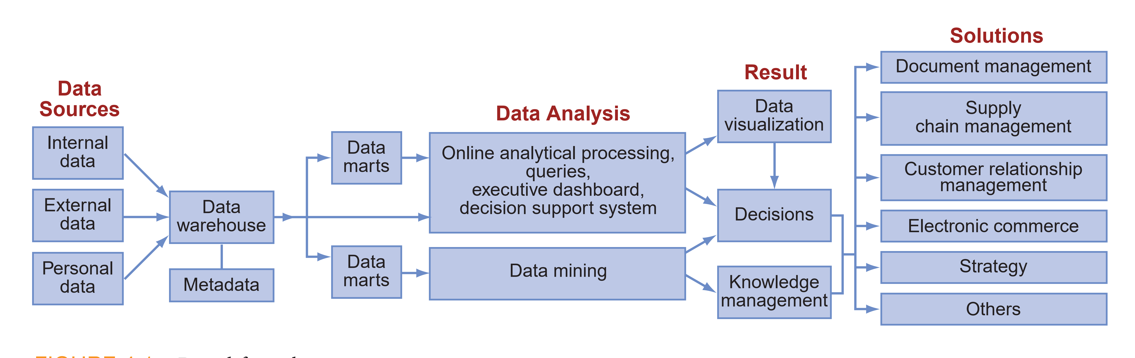
Data Life Cycle
NMCNTT- FIT - HCMUS

Slide 69
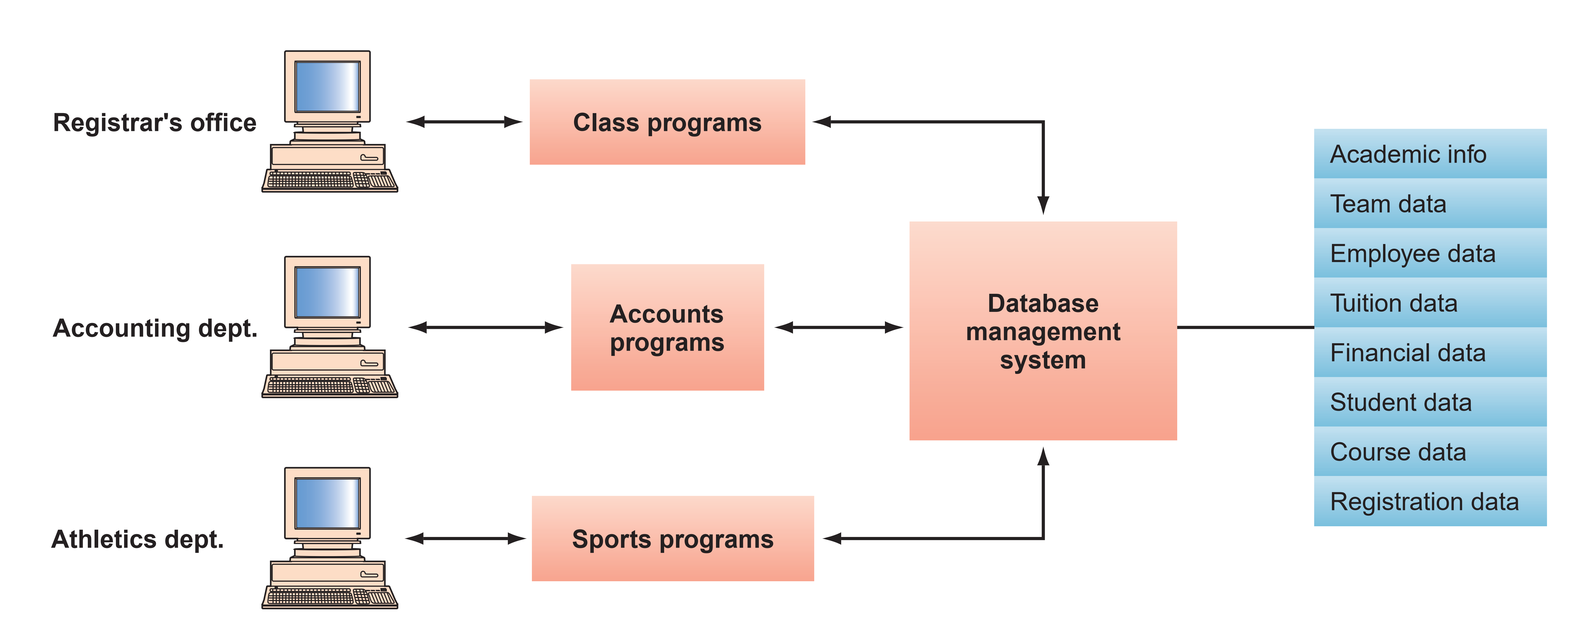
Database Approach
A database management system (DBMS) provides access to all data in the database.
NMCNTT- FIT - HCMUS

Slide 70
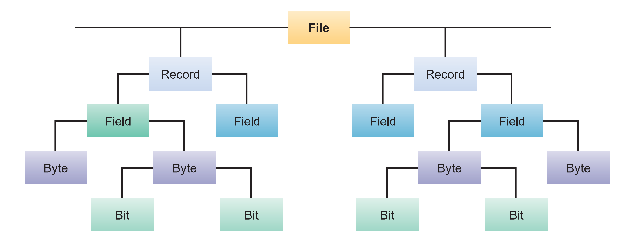
Data Hierarchy
Hierarchy of data for a computer-based file.
NMCNTT- FIT - HCMUS

Slide 71
Database
Central repository of shared data
Data is managed by a controlling agent
Stored in a standardized, convenient form
Central Database
Contains employee,
order, inventory,
pricing, and
customer data
Requires a Database Management System (DBMS)
NMCNTT- FIT - HCMUS
Notes:
Kho tập trung dữ liệu trung phục vụ cho sự chia sẻ
Dữ liệu được quản lý bởi một tác nhân kiểm soát
Được lưu trữ theo chuẩn, định dạng thuận tiện

Slide 72
Database Management System
A software system that is used to create, maintain, and provide controlled access to user databases
Order Filing
System
Central database
Contains employee,
order, inventory,
pricing, and
customer data
Invoicing
System
DBMS
Payroll
System
DBMS manages data resources like an operating system manages hardware resources
NMCNTT- FIT - HCMUS

Slide 73
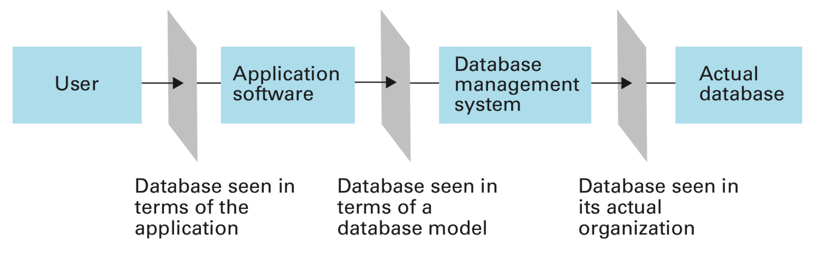
Conceptual layers of a database implementation
From Brookshear, 2015
NMCNTT - FIT - HCMUS

Slide 74
Database models
A conceptual view of a database
Entity Relationship Model (ERM)
Relational Model
Object-oriented Model
Hierarchical Model
NoSQL
…
ERM, Relational model is the most popular model
NMCNTT - FIT - HCMUS

Slide 75
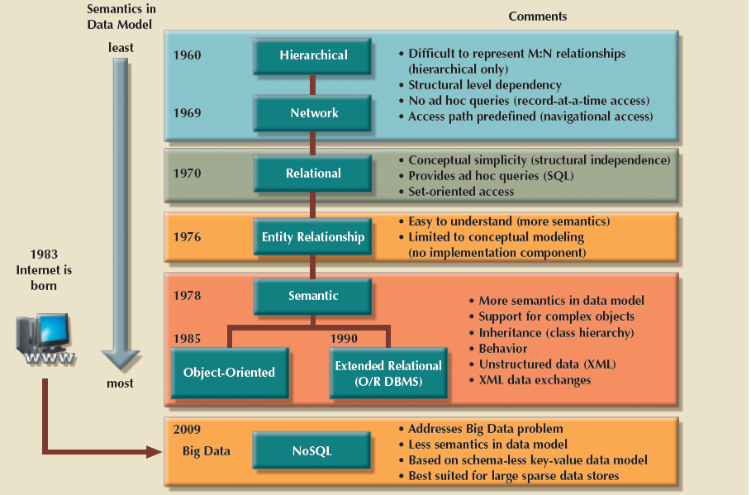
Evolution of Data Models
NMCNTT- FIT - HCMUS

Slide 76
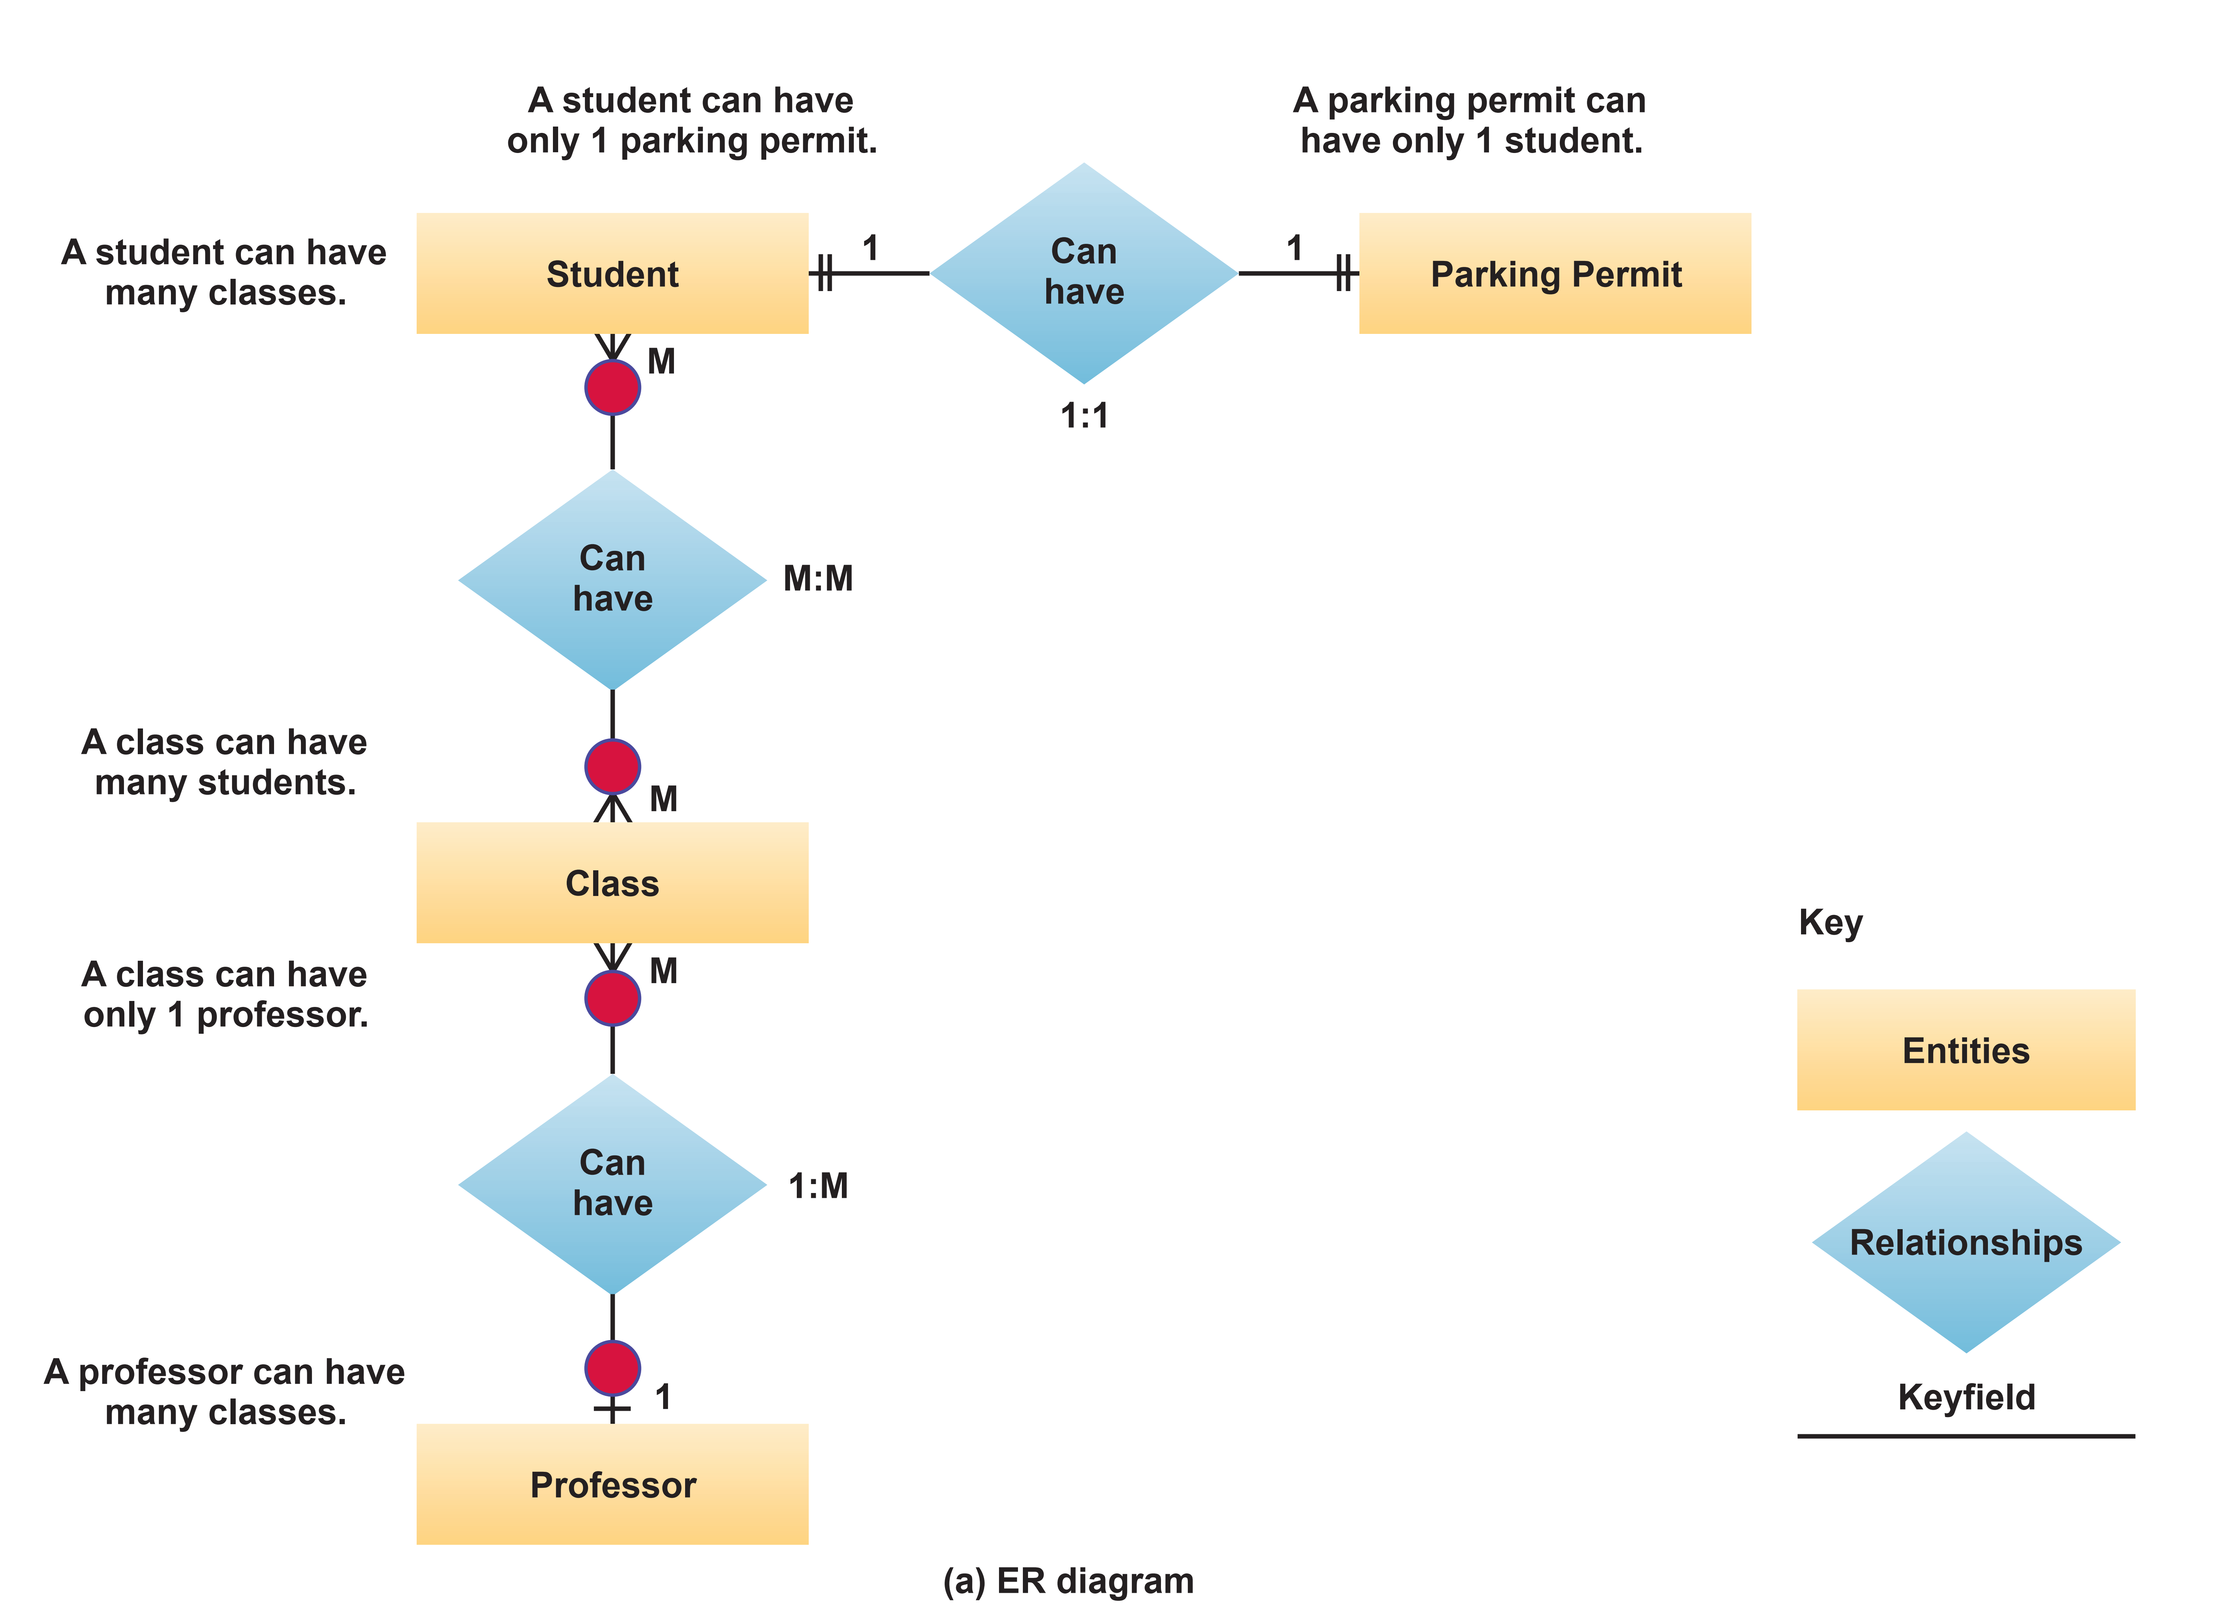
Entity Relationship Model
NMCNTT- FIT - HCMUS

Slide 77
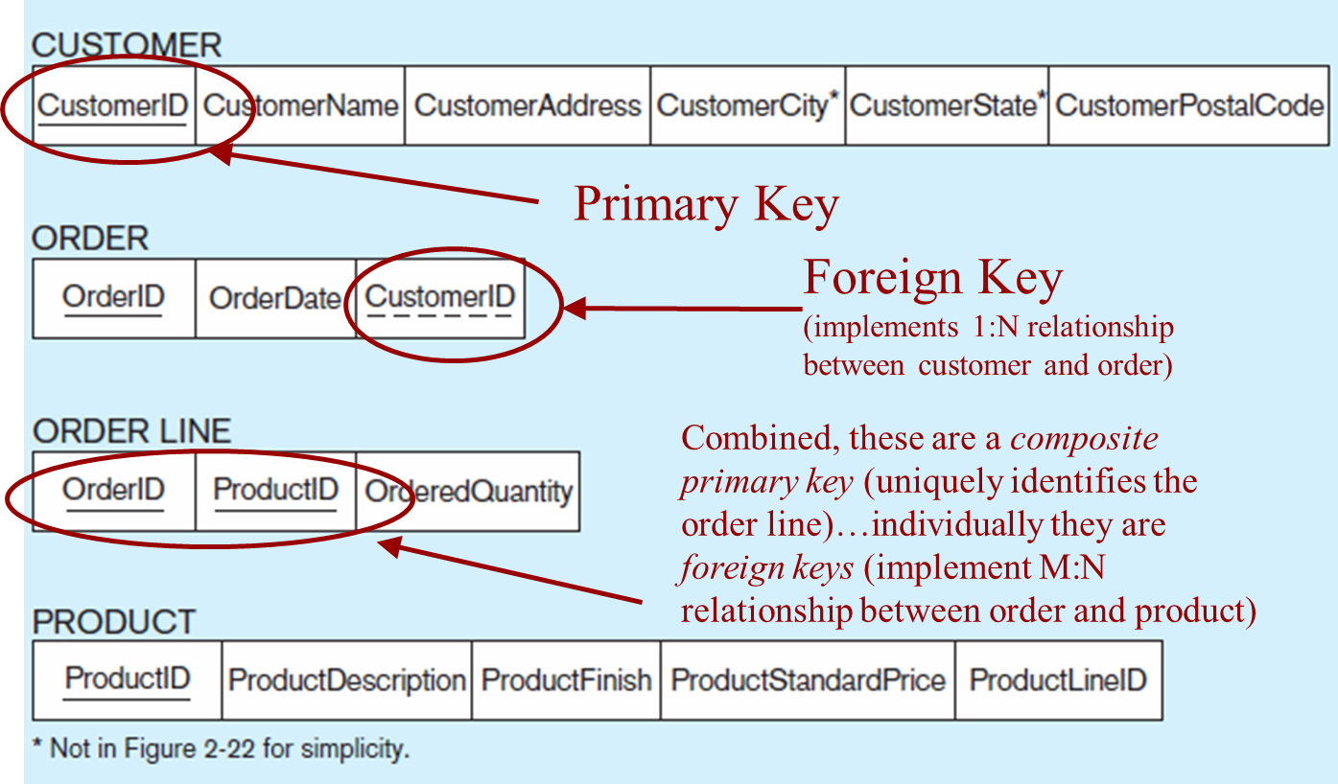
Relational database model
NMCNTT- FIT - HCMUS

Slide 78
Query Languages
Structured query language (SQL)
Operations to manipulate tuples
SELECT EmplId, Dept FROM Assignment, Job WHERE Assignment.JobId = Job.JobId AND Assignment.TermData = '*';
INSERT INTO Employee VALUES ('43212', 'Sue A. Burt',
'33 Fair St.', '444661111’);
DELETE FROM Employee WHERE Name = 'G. Jerry Smith';
UPDATE Employee SET Address = '1812 Napoleon Ave.' WHERE Name = 'Joe E. Baker';
NMCNTT- FIT - HCMUS

Slide 79
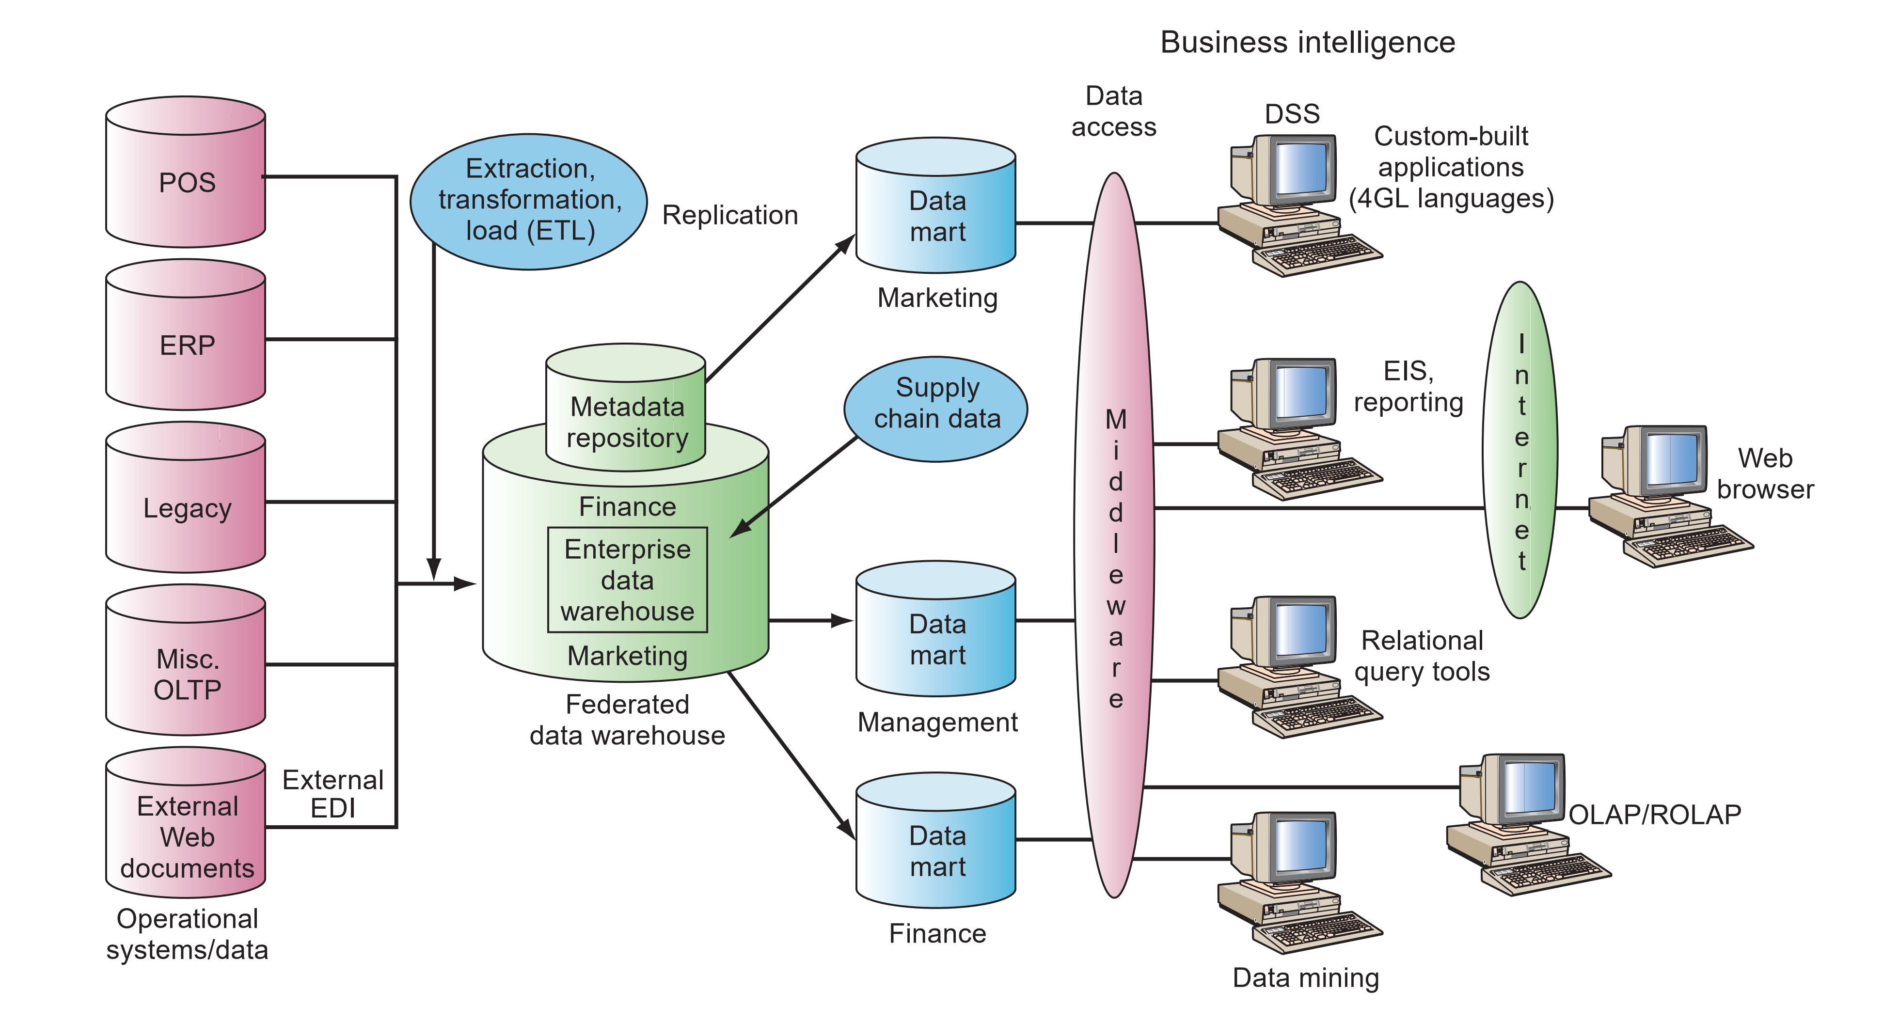
Datawarehouse
Data warehouse framework and views
NMCNTT- FIT - HCMUS

Slide 80
Careers in Information Systems
NMCNTT- FIT - HCMUS

Slide 81
Careers in Information Systems
Successful IS workers must:
Enjoy working in a fast-paced, dynamic environment
Meet deadlines and solving unexpected challenges
Possess good communication skills
Have solid analytical and decision-making skills
Develop effective team and leadership skills
Be adept at implementing organization change
Be prepared to engage in life-long learning
NMCNTT- FIT - HCMUS

Slide 82
Important Skills for IS Workers
Mobile applications for smartphones, tablet computers, and other mobile devices
Programing and application development
Help desk and technical support
Project management
Networking
Business intelligence
Security
Web 2.0
Data center

Slide 83
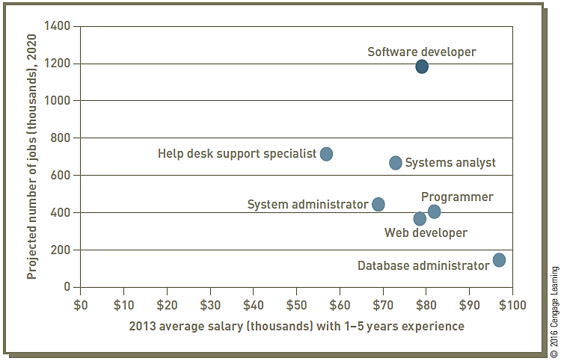
Occupational Outlook for Selected Information Systems Positions
NMCNTT- FIT - HCMUS

Slide 84
Roles, Functions, and Careers in IS
In addition to technical skills, IS professionals need:
Communication: skills in written and verbal communication
Problem solving
An understanding of organizations and the way they operate
Team work: ability to work with people and in groups
Etc.
NMCNTT- FIT - HCMUS

Slide 85
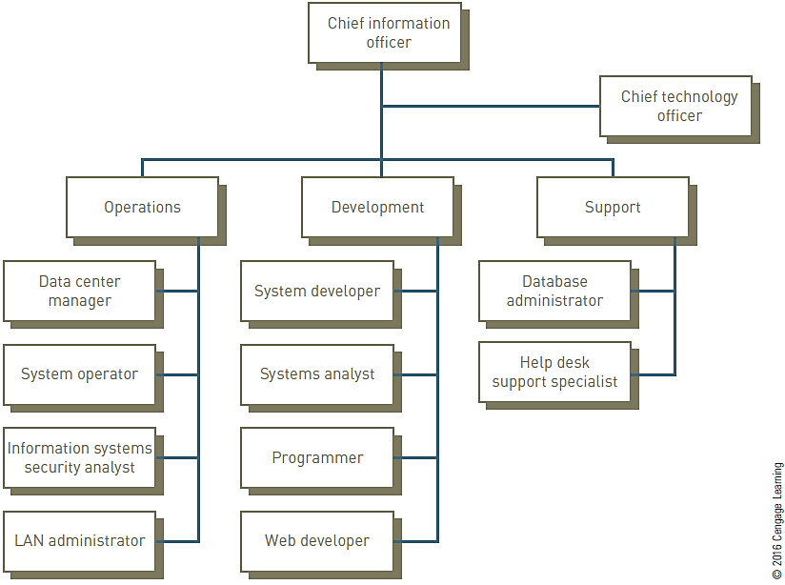
Three Primary Functions of the Information Systems Organization
NMCNTT- FIT - HCMUS

Slide 86
Typical IS Titles and Functions
Chief Information Officer (CIO) employs the IS department’s equipment and personnel to help the organization attain its goals
Senior IS Managers
IS Director
Vice President of Information Systems
Manager of Information Systems
Chief Technology Officer (CTO)
Information Management Manager
NMCNTT- FIT - HCMUS

Slide 87
Typical IS Titles and Functions: Operations Roles
Data center managers are responsible for the maintenance and operation of the organization’s computing facilities
Operations group includes:
Operations Manager
System Operators
Information System Security Analysts
NMCNTT- FIT - HCMUS

Slide 88
Typical IS Titles and Functions: Development Roles
The development group implements the new information systems required to support the organization’s existing and future business
The development group includes:
IS Project Manager
Systems Analyst, Business Analyst (BA)
Database designer, Web designer
Programmers
Web developers
NMCNTT- FIT - HCMUS

Slide 89
Typical IS Titles and Functions: Support
Provides customer service for the employees, customers, and business partners
The support group includes:
Database Administrators (DBAs)
Help Desk Support Specialists
NMCNTT- FIT - HCMUS

Slide 90
IS Careers in Technology Organizations
Consulting opportunities
Computer training
Computer and computer-equipment sales
Computer repair and maintenance
Many other related careers

Slide 91
Information Systems Majors – IS Department
NMCNTT- FIT - HCMUS

Slide 92

Bộ Môn HTTT
Room I84 – Phone 38354266 (804)
Head: Dr. Pham Nguyen Cuong
Vice head: Dr. Nguyen Tran Minh Thu

Slide 93
Educational objectives
Be able to analyze, evaluate, design, implement and operate projects of information system
Be able to utilize and self-study Information System development tools (analysis and design, software development via network / distributed / mobile environment)
Have self-development skills, do research of technologies, methodologies, new processes in Information System area

Slide 94

Building an Information System
What do we need to build an information system?
Identify the content of IS
Design IS and database
Store database
Building & Exploiting IS

Slide 95
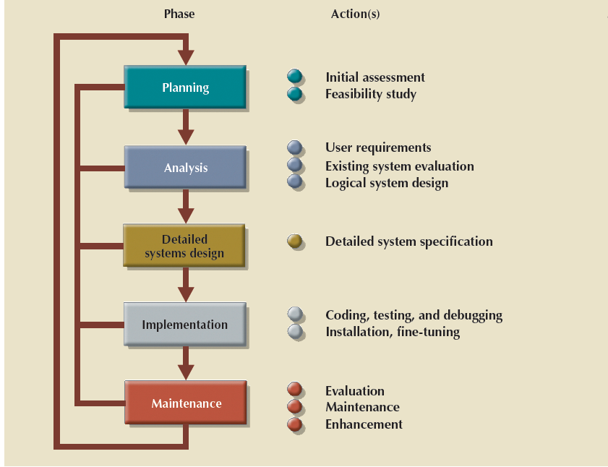
Systems Development Life Cycle (SDLC)
NMCNTT - FIT - HCMUS

Slide 96
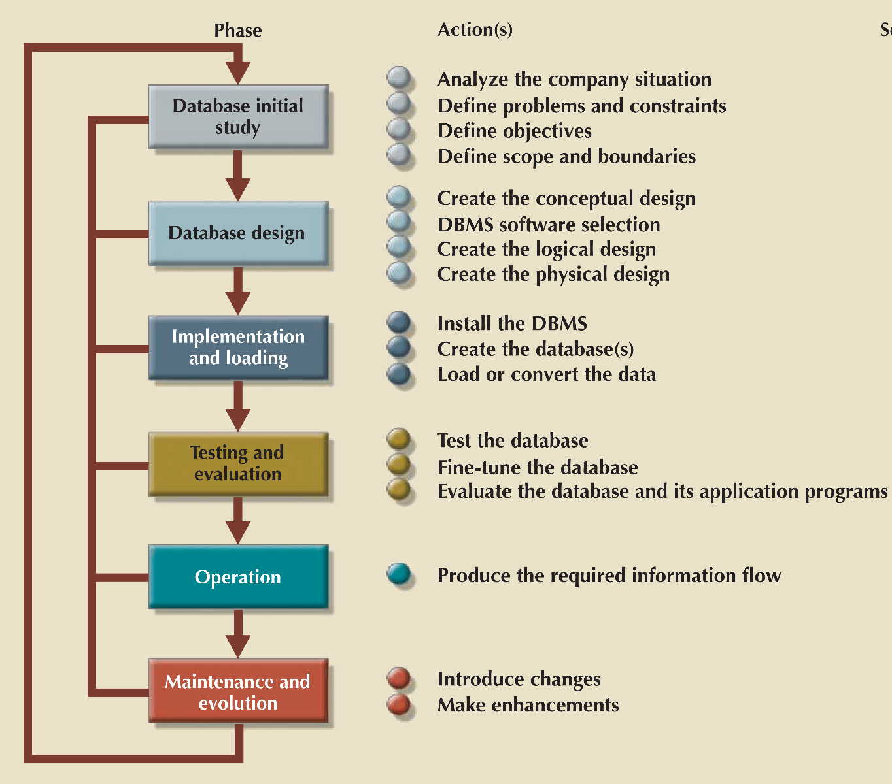
The Database Life Cycle (DBLC)
NMCNTT - FIT - HCMUS

Slide 97
Courses
Môn học cở sở và bắt buộc ngành
STT | Mã môn học | Tên môn học
1 | CSC10006 | Cơ sở dữ liệu
2 | CSC12001 | An toàn và bảo mật dữ liệu trong HTTT
3 | CSC12002 | Cơ sở dữ liệu nâng cao
4 | CSC12003 | Hệ quản trị cơ sở dữ liệu
5 | CSC12004 | Phân tích thiết kế HTTT
6 | CSC12005 | Phát triển ứng dụng HTTT hiện đại

Slide 98
Courses
Nhóm môn học tự chọn ngành
STT | Mã môn học | Tên môn học
1 | CSC12109 | Hệ thống thông tin doanh nghiệp
2 | CSC12107 | HTTT phục vụ trí tuệ kinh doanh
3 | CSC12102 | Chuyên đề chọn lọc trong HTTT
4 | CSC12105 | Thương mại điện tử
5 | CSC12106 | Tương tác người máy
6 | CSC12108 | Ứng dụng phân tán
7 | CSC10108 | Trực quan hóa dữ liệu
8 | CSC12103 | Chuyên đề Hệ QTCSDL NC
9 | CSC12110 | Ứng dụng phân tích dữ liệu
10 | CSC12111 | Quản trị CSDL hiện đại

Slide 99



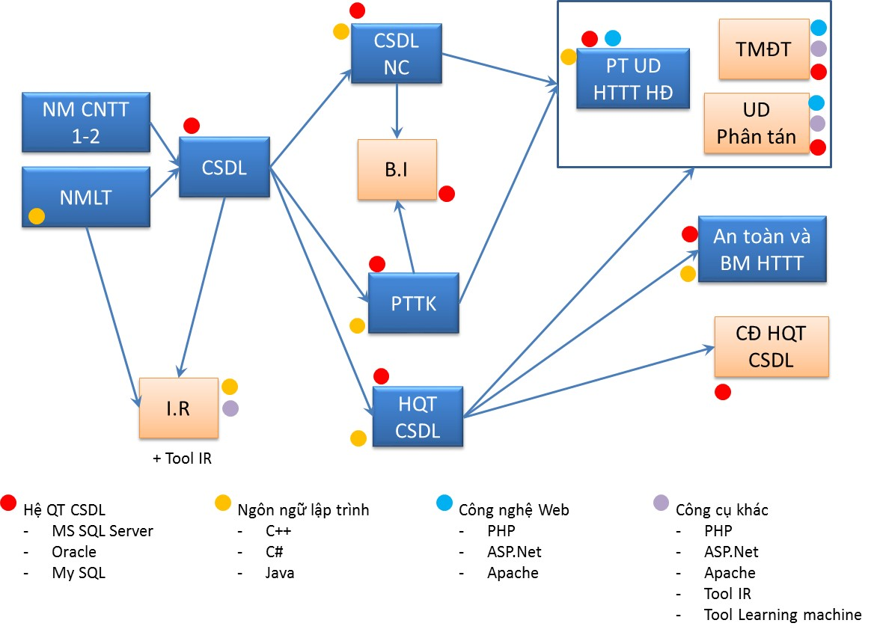
Courses
Chuỗi phát triển kỹ năng
Phân tích hệ thống
Thiết kế hệ thống
Cài đặt và
khai thác hệ thống
Database
Database
Tool Machine Learning

Slide 100
Courses
Database
Database Management System
Advanced Database
Identify the content of IS
Design IS and database
Store database
Exploit IS
Security issues in information systems
Selected topics on DBMS
Distributed Application

Slide 101
Courses (cont.)
IS Analysis & Design
Introduction to Enterprise Management
Electronic Commerce
Business process analysis
Business process design
Requirements of usability
Information Systems Development
Data Visualization
Human Computer Interaction
Elective courses of SE Dept.
IS for Business Intelligence

Slide 102
Research Groups
Khai thác văn bản và tìm kiếm thông tin
Khoa học dịch vụ, Học theo ngữ cảnh , Semantic Web, Smart Services
Hệ thống thông tin di động, CSDL di động, Internet of Things
Tích hợp lược đồ, Phân tích dữ liệu, kinh doanh thông minh (BI), Hệ thống tư vấn, BigData
Bảo mật cho hệ thống thông tin
Hệ thống hỗ trợ, mạng xã hội học tập

Slide 103
